Slide 1
Data Structures and Algorithms (m-way search tree)
Dr. Sambit Bakshi
Dept. of CSE, NIT Rourkela

Slide 2
m-Way Search Tree
An m-way search tree T may be an empty tree.
If T is non-empty, it satisfies the following properties:
For some integer m known as the order of the tree, each node has at most m child nodes.
A node may be represented as
A₀ , (K₁, A₁), (K₂, A₂) …. (K_{m-1} , A_{m-1} )
where K_{i} , 1 ≤ i ≤ m-1 are the keys and A_{i}, 0 ≤ i ≤ m-1 are the pointers to the subtree of T
If the node has c child nodes where c ≤ m, then the node can have only (c-1) keys, K₁ , K₂ , …… K_{c-1}
The keys in a node are ordered, i.e., K₁<K₂< …… <K_{c-1}

Slide 3
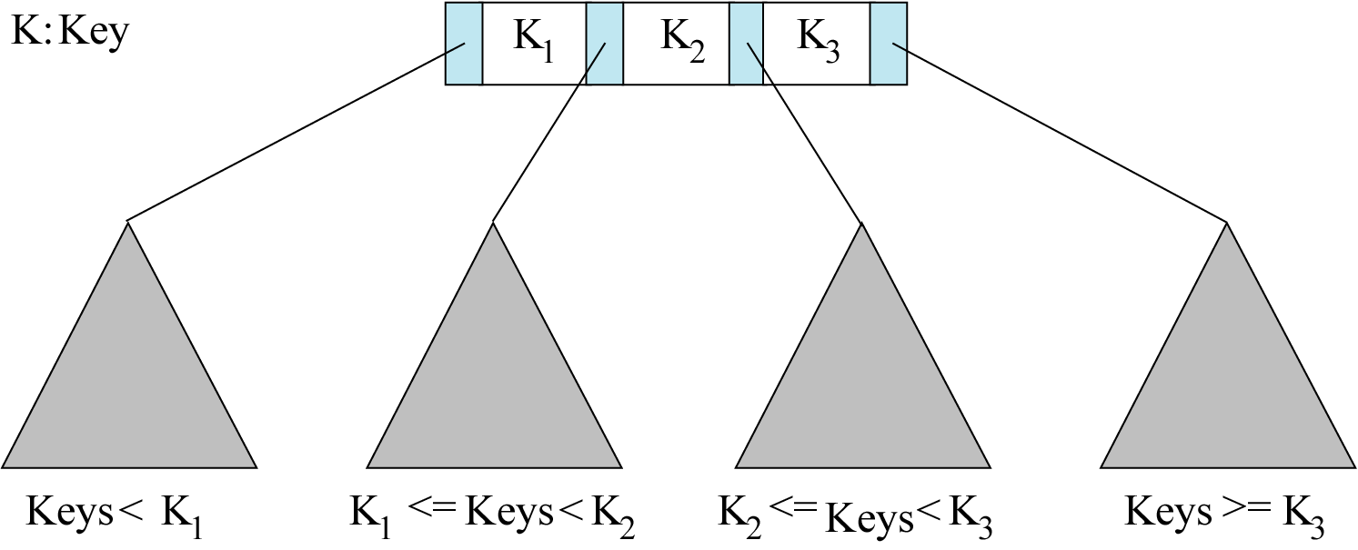
m-Way Search Tree
For a node A₀ , (K₁ , A₁), (K₂ , A₂) , …. (K_{m-1} , A_{m-1} ), if S_{i} is the subtree pointed by A_{i}, 0 ≤ i ≤ m-1then
Key(S₀)<K₁
Key(S_{m-1})>K_{m-1}
K_{i} < Key(S_{i}) < K_{i+1} , 1 ≤ i ≤ m-2
A₀
A₁
A₂
A₃
<
<
>

Slide 4
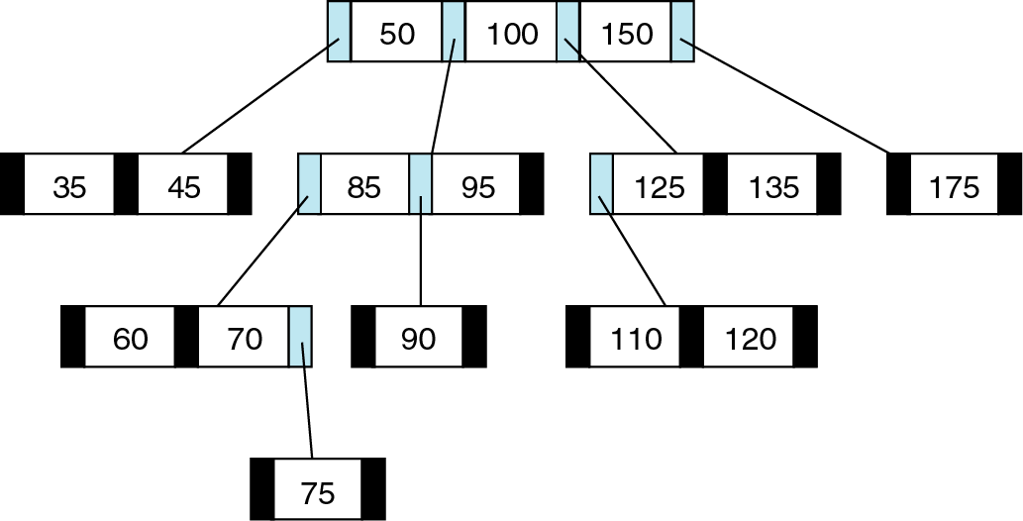
m-Way Search Tree
Each of the subtree A_{i} , 0 ≤ i ≤ m-1 are also m-way search tree
m-Way Search Tree [ m=4]

Slide 5
m-Way Search Tree [ m=5]
18 | 44 | 76 | 198
 | X | X
80 | 92 | 141
262
7 | 12
 | X | X
X
X |  | X
77
148 | 151 | 172 | 186
8 | 10
X | X
X | X | X | X | X
X | X | X
272 | 286 | 350
X | X | X | X

Slide 6
Searching in an m-Way Search Tree
Look for 77
18 | 44 | 76 | 198
 | X | X
80 | 92 | 141
262
7 | 12
 | X | X
X
X |  | X
77
148 | 151 | 172 | 186
8 | 10
X | X
X | X | X | X | X
X | X | X
272 | 286 | 350
X | X | X | X

Slide 7
Insertion in an m-Way Search Tree
Insert 6
18 | 44 | 76 | 198
 | X | X
80 | 92 | 141
262
7 | 12
 | X | X
X
X |  | X
77
148 | 151 | 172 | 186
8 | 10
X | X
X | X | X | X | X
X | X | X
272 | 286 | 350
X | X | X | X

Slide 8
Insertion in an m-Way Search Tree
Insert 6
18 | 44 | 76 | 198
 | X | X
Insert 146
80 | 92 | 141
262
6
7 | 12
 | X | X
X
X
X |  | X
77
148 | 151 | 172 | 186
8 | 10
X | X
X | X | X | X | X
X | X | X
272 | 286 | 350
X | X | X | X

Slide 9
Insertion in an m-Way Search Tree
Insert 6
18 | 44 | 76 | 198
 | X | X
Insert 146
80 | 92 | 141
262
6
7 | 12
 | X | X
X
X
X |  | X
77
148 | 151 | 172 | 186
8 | 10
X | X
 | X | X | X | X
X | X | X
272 | 286 | 350
146
X | X | X | X
X | X

Slide 10
Deletion in an m-Way Search Tree
Let K be the key to be deleted from the m-way search tree.
 |  | K
 |  | A_{i} | A_{j}
K : Key
A_{i} , A_{j} : Pointers to subtree

Slide 11
Deletion in an m-Way Search Tree
If (A_{i} = A_{j} = NULL) then delete K
If (A_{i} ≠ NULL, A_{j} = NULL ) then choose the largest of the key elements K’ in the subtree pointed to by A_{i} and replace K by K’.
If (A_{i} = NULL, A_{j} ≠ NULL ) then choose the smallest of the key element K” from the subtree pointed to by A_{j} , delete K” and replace K by K”.
If (A_{i} ≠ NULL, A_{j} ≠ NULL ) then choose the largest of the key elements K’ in the subtree pointed to by A_{i} or the smallest of the key element K” from the subtree pointed to by A_{j} to replace K.

Slide 12
5-Way Search Tree
Delete 151
18 | 44 | 76 | 198
 | X | X
80 | 92 | 141
262
7 | 12
 | X | X
X
X |  | X
77
148 | 151 | 172 | 186
8 | 10
X | X
X | X | X | X | X
X | X | X
272 | 286 | 350
X | X | X | X

Slide 13
5-Way Search Tree
Delete 151
18 | 44 | 76 | 198
 | X | X
80 | 92 | 141
262
7 | 12
 | X | X
X
X |  | X
77
148 | 172 | 186
8 | 10
X | X
X | X | X | X
X | X | X
272 | 286 | 350
X | X | X | X

Slide 14
5-Way Search Tree
Delete 12
18 | 44 | 76 | 198
 | X | X
80 | 92 | 141
262
7 | 12
 | X | X
X
X |  | X
77
148 | 151 | 172 | 186
8 | 10
X | X
X | X | X | X | X
X | X | X
272 | 286 | 350
X | X | X | X

Slide 15
5-Way Search Tree
Delete 12
18 | 44 | 76 | 198
 | X | X
80 | 92 | 141
262
7 | 10
 | X | X
X
X |  | X
77
148 | 151 | 172 | 186
8
X | X
X | X | X | X | X
X | X
272 | 286 | 350
X | X | X | X

Slide 16
5-Way Search Tree
Delete 18
18 | 44 | 76 | 198
--Delete 12
--Replace 18 by 12
 | X | X
80 | 92 | 141
262
7 | 12
 | X | X
X
X |  | X
77
148 | 151 | 172 | 186
8 | 10
X | X
X | X | X | X | X
X | X | X
272 | 286 | 350
X | X | X | X

Slide 17
5-Way Search Tree
Delete 18
18 | 44 | 76 | 198
--Delete 12
--Replace 18 by 12
 | X | X
80 | 92 | 141
262
7 | 10
 | X | X
X
X |  | X
77
148 | 151 | 172 | 186
8
X | X
X | X | X | X | X
X | X
272 | 286 | 350
X | X | X | X

Slide 18
5-Way Search Tree
Delete 18
12 | 44 | 76 | 198
--Delete 12
--Replace 18 by 12
 | X | X
80 | 92 | 141
262
7 | 10
 | X | X
X
X |  | X
77
148 | 151 | 172 | 186
8
X | X
X | X | X | X | X
X | X
272 | 286 | 350
X | X | X | X

Slide 19
5-Way Search Tree
Delete 262
18 | 44 | 76 | 198
 | X | X
80 | 92 | 141
262
7 | 12
 | X | X
X
X |  | X
77
148 | 151 | 172 | 186
8 | 10
X | X
X | X | X | X | X
X | X | X
272 | 286 | 350
X | X | X | X

Slide 20
5-Way Search Tree
Delete 262
18 | 44 | 76 | 198
 | X | X
80 | 92 | 141
272
7 | 12
 | X | X
X
X |  | X
77
148 | 151 | 172 | 186
8 | 10
X | X
X | X | X | X | X
X | X | X
286 | 350
X | X | X

Slide 21
5-Way Search Tree
Delete 198
18 | 44 | 76 | 198
--delete186
--replace 198 by 186
 | X | X
80 | 92 | 141
262
7 | 12
 | X | X
X
X |  | X
77
148 | 151 | 172 | 186
8 | 10
X | X
X | X | X | X | X
X | X | X
272 | 286 | 350
X | X | X | X

Slide 22
5-Way Search Tree
Delete 198
18 | 44 | 76 | 198
--delete186
--replace 198 by 186
 | X | X
80 | 92 | 141
262
7 | 12
 | X | X
X
X |  | X
77
148 | 151 | 172
8 | 10
X | X
X | X | X | X
X | X | X
272 | 286 | 350
X | X | X | X

Slide 23
5-Way Search Tree
Delete 198
18 | 44 | 76 | 186
--delete186
--replace 198 by 186
 | X | X
80 | 92 | 141
262
7 | 12
 | X | X
X
X |  | X
77
148 | 151 | 172
8 | 10
X | X
X | X | X | X
X | X | X
272 | 286 | 350
X | X | X | X

Slide 24
5-Way Search Tree
Delete 198
18 | 44 | 76 | 198
--delete 262
--replace 198 by 262
 | X | X
80 | 92 | 141
262
7 | 12
 | X | X
X
X |  | X
77
148 | 151 | 172 | 186
8 | 10
X | X
X | X | X | X | X
X | X | X
272 | 286 | 350
X | X | X | X

Slide 25
5-Way Search Tree
Delete 198
18 | 44 | 76 | 198
--delete 262
--replace 198 by 262
 | X | X
80 | 92 | 141
272
7 | 12
 | X | X
X
X |  | X
77
148 | 151 | 172 | 186
8 | 10
X | X
X | X | X | X | X
X | X | X
286 | 350
X | X | X

Slide 26
5-Way Search Tree
Delete 198
18 | 44 | 76 | 262
--delete 262
--replace 198 by 262
 | X | X
80 | 92 | 141
272
7 | 12
 | X | X
X
X |  | X
77
148 | 151 | 172 | 186
8 | 10
X | X
X | X | X | X | X
X | X | X
286 | 350
X | X | X

Slide 27
B Trees
B tree is a balanced m-way search tree
A B tree of order m, if non empty, is an m-way search tree in which
the root has at least two child pointers and at most m child pointers
nodes except the root have at least ⎡m/2⎤ child pointers and at most m child pointers
all leaf nodes are on the same level

Slide 28
B Tree of order 5
48
56 | 64 | 85
31 | 45
46 | 47
X | X | X
87 | 88 | 100 | 112
10 | 18 | 21
X | X | X | X | X
X | X | X | X
58 | 62
X | X | X
49 | 51 | 52
36 | 40 | 42
X | X | X | X
X | X | X | X
67 | 75
X | X | X

Slide 29
Searching a B Tree
Searching for a key in a B-tree is similar to the one on an m-way search tree.
The number of accesses depends on the height h of the B-tree

Slide 30
Insertion in a B-Tree
Attempt to insert the new key into a leaf
If this would result in that leaf becoming too big, split the leaf into two, promoting the middle key to the leaf’s parent
If this would result in the parent becoming too big, split the parent into two, promoting the middle key
This strategy might have to be repeated all the way to the top
If necessary, the root is split in two and the middle key is promoted to a new root, making the tree one level higher

Slide 31
Constructing a B-tree
Suppose we start with an empty B-tree and keys arrive in the following order:1 12 8 2 25 6 14 28 17 7 52 16 48 68 3 26 29 53 55 45
We want to construct a B-tree of order 5
The first four items go into the root:
To put the fifth item in the root would over-fill it
Therefore, when 25 arrives, pick the middle key to make a new root
1
2
8
12

Slide 32
Constructing a B-tree
Add 25 to the tree
1 12 8 2 25 6 14 28 17 7 52 16 48 68 3 26 29 53 55 45
Exceeds Order. Promote middle and split.
1
2
8
12
25

Slide 33
Constructing a B-tree (contd.)
8
1 12 8 2 25 6 14 28 17 7 52 16 48 68 3 26 29 53 55 45
1
2
12
25
6, 14, 28 get added to the leaf nodes:
8
1
2
6
14
28
1
2
12
25

Slide 34
Constructing a B-tree (contd.)
Adding 17 to the right leaf node would over-fill it, so we take the middle key, promote it (to the root) and split the leaf
8
1 12 8 2 25 6 14 28 17 7 52 16 48 68 3 26 29 53 55 45
1 12 8 2 25 6 14 28 17 7 52 16 48 68 3 26 29 53 55 45
25
28
28
1
2
6
17
2
12
14

Slide 35
Constructing a B-tree (contd.)
7, 52, 16, 48 get added to the leaf nodes
8
17
1 12 8 2 25 6 14 28 17 7 52 16 48 68 3 26 29 53 55 45
7
25
28
48
1
2
6
12
14
52
16

Slide 36
Constructing a B-tree (contd.)
Adding 68 causes us to split the right most leaf, promoting 48 to the root
1 12 8 2 25 6 14 28 17 7 52 16 48 68 3 26 29 53 55 45
8
17
1
2
6
7
12
14
16
25
28
48
52
68

Slide 37
Constructing a B-tree (contd.)
Adding 3 causes us to split the left most leaf
8
17
48
1 12 8 2 25 6 14 28 17 7 52 16 48 68 3 26 29 53 55 45
7
2
6
7
12
14
16
1
3
25
28
52
68

Slide 38
Constructing a B-tree (contd.)
Add 26, 29, 53, 55 then go into the leaves
3
8
17
48
1 12 8 2 25 6 14 28 17 7 52 16 48 68 3 26 29 53 55 45
1
2
6
7
12
14
16
25
26
28
52
53
68
55
29

Slide 39
Constructing a B-tree (contd.)
Add 45 increases the trees level
Exceeds Order. Promote middle and split.
1 12 8 2 25 6 14 28 17 7 52 16 48 68 3 26 29 53 55 45
Exceeds Order. Promote middle and split.
3
8
17
48
1
2
6
7
12
14
16
25
26
28
29
45
52
53
55
68

Slide 40
Exercise in Inserting a B-Tree
Insert the following keys to a 5-way B-tree:
3, 7, 9, 23, 45, 1, 5, 14, 25, 24, 13, 11, 8, 19, 4, 31, 35, 56

Slide 41
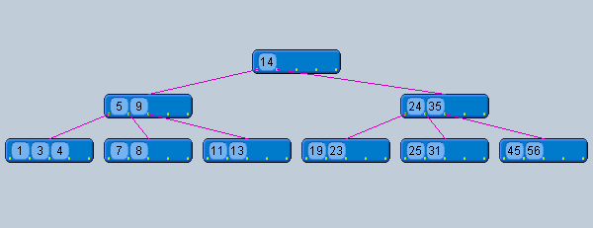
Answer to Exercise

Slide 42
Delete from a B-tree
If the key is already in a leaf node, and removing it doesn’t cause that leaf node to have too few keys, then simply remove the key to be deleted.
If the key is not in a leaf then it is guaranteed (by the nature of a B-tree) that its predecessor or successor will be in a leaf -- in this case can we delete the key and promote the predecessor or successor key to the non-leaf deleted key’s position.

Slide 43
Removal from a B-tree (2)
If (1) or (2) lead to a leaf node containing less than the minimum number of keys then we have to look at the siblings immediately adjacent to the leaf in question:
3: if one of them has more than the min’ number of keys then we can promote one of its keys to the parent and take the parent key into our lacking leaf
4: if neither of them has more than the min’ number of keys then the lacking leaf and one of its neighbours can be combined with their shared parent (the opposite of promoting a key) and the new leaf will have the correct number of keys; if this step leave the parent with too few keys then we repeat the process up to the root itself, if required

Slide 44
Type #1: Simple leaf deletion
Assuming a 5-way
B-Tree, as before...
12
29
52
2
7
9
15
22
31
43
56
69
72
Delete 2: Since there are enough
keys in the node, just delete it
Note when printed: this slide is animated

Slide 45
Type #2: Simple non-leaf deletion
12
29
52
56
Delete 52
7
9
15
22
31
43
56
69
72
Borrow the predecessor
or (in this case) successor
Note when printed: this slide is animated

Slide 46
Type #3: Enough siblings
12
29
Demote root key and
promote leaf key
7
9
15
22
31
43
56
69
Delete 22
Note when printed: this slide is animated

Slide 47
Type #3: Enough siblings
12
31
7
9
15
29
43
56
69
Note when printed: this slide is animated

Slide 48
Type #4: Too few keys in node and its siblings
12
29
56
Join back together
7
9
15
22
31
43
69
72
Too few keys!
Delete 72
Note when printed: this slide is animated

Slide 49
Type #4: Too few keys in node and its siblings
12
29
7
9
15
22
31
43
56
69
Note when printed: this slide is animated

Slide 50
Exercise in Removal from a B-Tree
Given 5-way B-tree created by these data (last exercise):
3, 7, 9, 23, 45, 1, 5, 14, 25, 24, 13, 11, 8, 19, 4, 31, 35, 56
Add these further keys: 2, 6,12
Delete these keys: 4, 5, 7, 3, 14

Slide 51
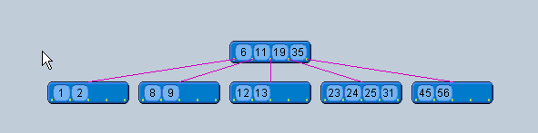
Answer to Exercise

Slide 52
5-Way B Tree (insertion examples)
8 | 96 | 116
2 | 7
104 | 110
137 | 145
37 | 46 | 55 | 86
X | X | X
X | X | X | X | X
X | X | X
X | X | X
Insert 4, 5, 58, 6 in the order

Slide 53
5-Way B Tree (insertion examples)
8 | 96 | 116
104 | 110
137 | 145
37 | 46 | 55 | 86
X | X | X | X | X
X | X | X
X | X | X
2 | 4 | 7
X | X | X | X
Search tree after inserting 4

Slide 54
5-Way B Tree (insertion examples)
8 | 96 | 116
104 | 110
137 | 145
37 | 46 | 55 | 86
X | X | X | X | X
X | X | X
X | X | X
2 | 4 | 5 | 7
X | X | X | X | X
Search tree after inserting 4, 5

Slide 55
5-Way B Tree (insertion examples)
Insert 58
8 | 96 | 116
104 | 110
137 | 145
37 | 46 | 55 | 86
X | X | X | X | X
X | X | X
X | X | X
2 | 4 | 5 | 7
X | X | X | X | X
37,46,55,58,86
Split the node at its median into two node, pushing the median element up by one level

Slide 56
5-Way B Tree (insertion examples)
Insert 55 in the root
8 | 96 | 116
104 | 110
137 | 145
37 | 46
X | X | X
X | X | X
X | X | X
2 | 4 | 5 | 7
58 | 86
X | X | X | X | X
X | X | X

Slide 57
5-Way B Tree (insertion examples)
8 | 55 | 96 | 116
104 | 110
137 | 145
37 | 46
X | X | X
X | X | X
X | X | X
2 | 4 | 5 | 7
58 | 86
X | X | X | X | X
X | X | X
Search tree after inserting 4, 5, 58

Slide 58
5-Way B Tree (insertion examples)
Insert 6
8 | 55 | 96 | 116
104 | 110
137 | 145
37 | 46
X | X | X
X | X | X
X | X | X
2 | 4 | 5 | 7
58 | 86
X | X | X | X | X
X | X | X
2,4,5,6,7
Split the node at its median into two node, pushing the median element up by one level

Slide 59
5-Way B Tree (insertion examples)
Insert 5 at the root
8 | 55 | 96 | 116
104 | 110
137 | 145
37 | 46
X | X | X
X | X | X
X | X | X
58 | 86
2 | 4
6 | 7
X | X | X
X | X | X
X | X | X

Slide 60
5-Way B Tree (insertion examples)
55
Insert 5 at the root
5 | 8
96 | 116
104 | 110
137 | 145
37 | 46
X | X | X
X | X | X
X | X | X
58 | 86
2 | 4
6 | 7
X | X | X
X | X | X
X | X | X

Slide 61
5-Way B Tree (insertion examples)
55
Insert 5 at the root
96 | 116
5 | 8
137 | 145
58 | 86
2 | 4
37 | 46
X | X | X
X | X | X
X | X | X
X | X | X
104 | 110
6 | 7
X | X | X
X | X | X

Slide 62
B-tree of Order 5 (deletion examples)
110
65 | 86
120 | 226
32 | 44
70 | 81
115 | 118
200 | 221
X | X | X
X | X | X
X | X | X
X | X | X
90 | 95 | 100
X | X | X | X
300 | 440 | 550 | 601
X | X | X | X | X
Delete 95, 226, 221, 70

Slide 63
B-tree of Order 5
delete 226
110
65 | 86
120 | 226
32 | 44
70 | 81
115 | 118
200 | 221
X | X | X
X | X | X
X | X | X
X | X | X
90 | 100
X | X | X
300 | 440 | 550 | 601
X | X | X | X | X
B-tree after deleting 95

Slide 64
B-tree of Order 5
110
65 | 86
120 | 300
32 | 44
70 | 81
115 | 118
200 | 221
X | X | X
X | X | X
X | X | X
X | X | X
90 | 100
X | X | X
300 | 440 | 550 | 601
X | X | X | X | X

Slide 65
B-tree of Order 5
110
Delete 221
65 | 86
120 | 300
32 | 44
70 | 81
115 | 118
200 | 221
X | X | X
X | X | X
X | X | X
X | X | X
90 | 100
X | X | X
440 | 550 | 601
X | X | X | X
B-tree after deleting 95, 226

Slide 66
B-tree of Order 5
110
Delete 70
65 | 86
120 | 440
32 | 44
70 | 81
115 | 118
200 | 300
X | X | X
X | X | X
X | X | X
X | X | X
90 | 100
X | X | X
550 | 601
X | X | X
B-tree after deleting 95, 226, 221

Slide 67
B-tree of Order 5
110
Delete 65
65 | 86
120 | 440
32 | 44
65 | 81
115 | 118
200 | 300
X | X | X
X | X
X | X | X
X | X | X
90 | 100
X | X | X
550 | 601
X | X | X

Slide 68
B-tree of Order 5
86
110
120 | 440
32 | 44
65 | 81
115 | 118
200 | 300
X | X | X
X | X
X | X | X
X | X | X
90 | 100
X | X | X
550 | 601
X | X | X
B-tree after deleting 95, 226, 221, 70

Slide 69
Heap
Suppose H is a complete binary tree with n elements
H is called a heap or maxheap if each node N of H has the following property
Value at N is greater than or equal to the value at each of the children of N.

Slide 70
Heap
97
88
95
95
48
66
55
25
38
66
35
48
55
62
77
40
30
26
24
18
97 | 88 | 95 | 66 | 55 | 95 | 48 | 66 | 35 | 48 | 55 | 62 | 77 | 25 | 38 | 18 | 40 | 30 | 26 | 24
1 | 2 | 3 | 4 | 5 | 6 | 7 | 8 | 9 | 10 | 11 | 12 | 13 | 14 | 15 | 16 | 17 | 18 | 19 | 20

Slide 71
Inserting into a Heap
Suppose H is a heap with N elements
Suppose an ITEM of information is given.
Insertion of ITEM into heap H is given as follows:
[1] First adjoin ITEM at the end of H so that H is still a complete tree, but necessarily a heap
[2] Let ITEM rise to its appropriate place in H so that H is finally a heap

Slide 72
Heap
Insert 70
97
88
95
95
48
66
55
25
38
66
35
48
55
62
77
26
24
70
18
40
30
97 | 88 | 95 | 66 | 55 | 95 | 48 | 66 | 35 | 48 | 55 | 62 | 77 | 25 | 38 | 18 | 40 | 30 | 26 | 24
1 | 2 | 3 | 4 | 5 | 6 | 7 | 8 | 9 | 10 | 11 | 12 | 13 | 14 | 15 | 16 | 17 | 18 | 19 | 20

Slide 73
Heap
Insert 70
97
88
95
95
48
66
55
25
38
66
35
48
55
62
77
26
24
70
18
40
30
97 | 88 | 95 | 66 | 55 | 95 | 48 | 66 | 35 | 48 | 55 | 62 | 77 | 25 | 38 | 18 | 40 | 30 | 26 | 24
1 | 2 | 3 | 4 | 5 | 6 | 7 | 8 | 9 | 10 | 11 | 12 | 13 | 14 | 15 | 16 | 17 | 18 | 19 | 20

Slide 74
Heap
Insert 70
97
88
95
95
48
66
55
25
38
66
35
70
55
62
77
26
24
48
18
40
30
97 | 88 | 95 | 66 | 55 | 95 | 48 | 66 | 35 | 48 | 55 | 62 | 77 | 25 | 38 | 18 | 40 | 30 | 26 | 24
1 | 2 | 3 | 4 | 5 | 6 | 7 | 8 | 9 | 10 | 11 | 12 | 13 | 14 | 15 | 16 | 17 | 18 | 19 | 20

Slide 75
Heap
Insert 70
97
88
95
95
48
66
70
25
38
66
35
55
55
62
77
26
24
48
18
40
30
97 | 88 | 95 | 66 | 55 | 95 | 48 | 66 | 35 | 48 | 55 | 62 | 77 | 25 | 38 | 18 | 40 | 30 | 26 | 24
1 | 2 | 3 | 4 | 5 | 6 | 7 | 8 | 9 | 10 | 11 | 12 | 13 | 14 | 15 | 16 | 17 | 18 | 19 | 20

Slide 76
Build a Heap
Build a heap from the following list
44, 30, 50, 22, 60, 55, 77, 55

Slide 77
44, 30, 50, 22, 60, 55, 77, 55
44
44
44
50
50
30
30
50
44
30
30
44
22
Complete the Rest Insertion
77
55
60
50
30
44
55
22

Slide 78
Deleting the Root of a Heap
Suppose H is a heap with N elements
Suppose we want to delete the root R of H
Deletion of root is accomplished as follows
[1] Assign the root R to some variable ITEM
[2] Replace the deleted node R by the last node L of H so that H is still a complete tree but necessarily a heap
[3] Reheap. Let L sink to its appropriate place in H so that H is finally a heap.

Slide 79
95
22
85
70
85
70
55
33
30
65
55
33
30
65
15
20
15
22
15
20
15
85
85
22
70
55
70
33
65
22
33
30
65
55
30
15
20
15
15
20
15

